Slide 1

Machine Learning / Data Science Project Scoping
Rayid Ghani and Kit Rodolfa

Slide 2
Why Scoping is Critical
Increases the likelihood of use and impact
Allows everyone to focus on the outcomes we should care about

Slide 3
Before Scoping: Initial Screening Criteria
Real and significant problem (with clear social impact)
Priority for the leadership of the organization
Commitments in place:
People commitment and data available to do the project
Commitment from the organization that owns data
Commitment to take actions and validate the solution

Slide 4
Overview: Scoping the Problem
Define a concrete problem and a specific goal you are trying to influence
Identify whether you have a real opportunity to influence the goal
What actions can you take?
What data do you have and will need?
What analysis will need to be done and how will you validate the analysis?
Ensure you have a champion with the authority to move resources and set expectations for participation and collaboration

Slide 5
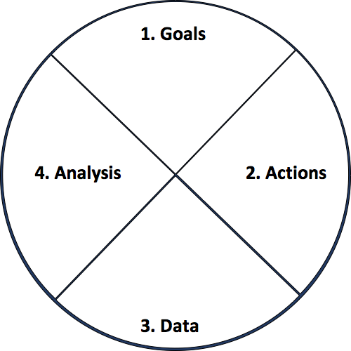
Actionable and Goal-Driven Project Scope
Goals: Define the goal(s) of the project
Actions: What actions/interventions will you inform?
Data: What data do you have internally? What data do you need? What can you augment from external and public sources?
Analysis: What analysis needs to be done? How will it be validated?
‹#›
dsapp.uchicago.edu
@datascifellows
Center for Data Science and Public Policy University of Chicago

Slide 6



Step 1: Determine Goals
Efficiency
Effectiveness
Equity/Fairness

Slide 7
Step 1: Determine Goals
Goals need to be measurable and concrete
Goal is NOT to build a model, make a prediction, etc.
What are the relative priorities and tradeoffs for each goal?
What constraints do you face in achieving these goals?
Stakeholder involvement from the beginning is key
Notes:
Stakeholders need to be bought in from the beginning or it won’t be effective

Slide 8
Problem Templates
Can I detect who’s going to get lead poisoning early?
Can I determine which home inspections to prioritize?
How do I improve the scheduling and assignment of my medics/ambulances/firetrucks?
Can I route citizen requests more efficiently and effectively?
Which policies do I modify to improve maternal mortality ?
How much impact is my after-school program having?
Can I get data that helps me match employers with employees ?
X
X
X
X
X
X
X

Slide 9
Types of Problems
Early Warning Systems
Compliance/Inspections/Audits
Routing (Physical or Virtual)
Scheduling
Policy Evaluation
Policy Hypothesis Generation

Slide 10
Step 2: Identify Actions to achieve the goal
What interventions do I have access to?
What would they do differently if they had more information/knew where their interventions were most likely to be effective?
Informing these actions:
Who? (to target for each action)
What? (to say to them)
How? (to use different communication channels)
Notes:
Stakeholders need to be bought in from the beginning or it won’t be effective

Slide 11
Step 2: Identify Actions to achieve the goal
Focus on concrete actions
Existing vs new actions
Consider the granularity of the actions
e.g. students who need help generally vs specific program
How frequently are interventions taken/planned?
How far out does planning occur?
Notes:
Stakeholders need to be bought in from the beginning or it won’t be effective

Slide 12
Step 3: Data Sources
What relevant data sources do you have?
What data do you need?
Important to match the granularity, frequency, and time horizon of the actions to the data
What external data can you augment this with?
dsapp.uchicago.edu

Slide 13
Step 3: Data Sources
Types of Data
Nobody knows what data the entire organization has
Don’t get intimidated by legal acronyms thrown at you
Data is never perfect – is it useful enough to improve over status quo?
Program Level
Transactional
Spatial
Text
Images/Audio/Video

Slide 14
Step 3: Data Sources
How reliable is the data?
How current is it?
How much of it is computer-readable?
How much of it is stored as notes, audio, photos, videos?
What resources and authority do you have to collect more?

Slide 15
Step 4: Analysis
What analysis needs to be done?
What type of methods should be used?
How will the analysis be validated?

Slide 16
Types of Analysis Capabilities
Description (Understand the past)
Detection (Anomalies, Events, Patterns)
Prediction (Predict the Future)
Optimization
Behavior Change (Causal Inference)

Slide 17
Validation and Implementation Plan
Go back to the metrics and goals defined at the beginning of the project
Run a Pilot/Field Trial
Deploy
Set up Infrastructure and allocate resources to monitor “lift”

Slide 18
Creating a more equitable society
How do we define equity?
How do we detect inequity?
How do we increase equity?

Slide 19
Data and AI Ethics Issues
Privacy
Data Ownership
Bias, Equity, & Fairness
Transparency
Trustworthiness and Accountability

Slide 20
Levels of control
Collection Control
Access Control
Inference Control (Not inferring something about me)
Action Control (Not taking actions on me)

Slide 21
Data Ethics Questions
Are you using data for purposes it’s intended for?
How are you protecting the data?
Do the people who “own” the data know you’re using it?
Do you have their permission? How was it obtained?
What actions are you taking on individuals based on this data?
Do the people you’re targeting know why and if they’re being targeted?
What recourse do they have?
Would it make the front page of the national newspaper if they found out what you’re doing?

Slide 22
A Few Things to Remember
Don’t be afraid to ask naïve questions
Spend time discussing goals and metrics – don’t forget equity as a goal
Understand what the current process/solution is
Communication is critical – before, during, and after
We need to make sure that we tackle these problems responsibly and ethically
Data and Technology does not solve problems, people do.

Slide 23
Project Scoping Worksheet
http://bit.ly/dataprojectscoping

Slide 24
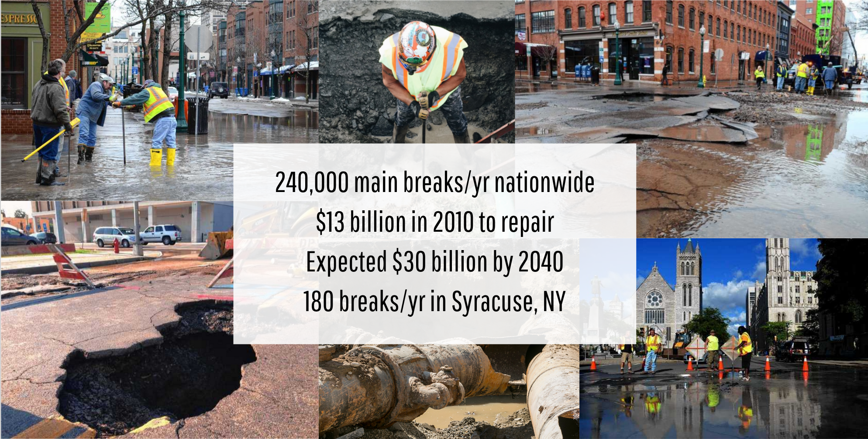
Case Study
240,000 main breaks/yr in US
$13 billion in 2010 to repair
Expected $30 billion by 2040
180 breaks/yr in Syracuse, NY

Slide 25
Reminders
Tech setup instructions on Piazza
Make sure you can do everything described in the announcement
Not on the course Piazza? http://piazza.com/cmu/spring2020/10718
Need help with the setup?
Today after class (4:30-5pm) with Himil –– GHC 8th floor (by printer)
Tomorrow 10am-11am with Sebastian –– GHC 8009
Readings for Tuesday –– Scoping Case Studies:
Dengue Forecasting
Predicting Childhood Lead Poisoning
Algorithmic Decision Making in Health Care

